Slide 1
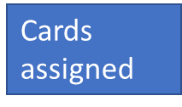
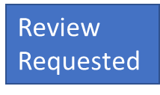



TILDE Email:
Cards assigned
Topic
Card id:
Title
Assignee
View content
Details
Project repo
Card id:
Title
Assignee
Reviewers assigned
View content
Details
Add review
Project repo
Card id:
Title
Assignee
Review feedback
View content
Details
Project link
Card id:
Title
View content
Details
Review Requested
Review Feedback
Complete

